Slide 1
CISC108
Introduction to Computer Science
[TA Name]
[TA Name]
University of Delaware
Week 8 - Monster Mash

Slide 2
[TA Name]
[TA Name]
[TA Photo]
[TA Photo]

Slide 3
Monster Mash
Same activity shared between Lecture and Practicum
Working in small groups to solve all problems
Split up all questions
Work in pairs/triples on questions
Work in parallel and share answers afterwards
Organize however your team sees fit
Goal: end up with a bunch of good solutions to help you study for the exam.
If finished, then you should work on other open assignments. Can leave if EVERYTHING is finished.

Slide 4
These slides available as reference for ad-hoc lectures!

Slide 5
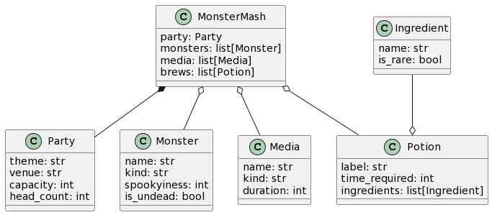
Monster Mash Class Diagram
spookiness:

Slide 6
Second MonsterMash example value
party2 = MonsterMash(
Party("Werewolf Bar Mitzvah", "30 Rockefeller Plaza", 5, 3),
[ Monster("Tracy Pawdan", "werewolf", 2, False),
Monster("Liz Lemoon", "werewolf", 1, False),
Monster("Bark Donaghy", "werewolf", 2, False) ],
[ Media("Werewolves of London", "song", 3),
Media("Teen Wolf", "movie", 92),
Media("Fetch", "game", 10) ],
[ Potion("Hair o' the Dog", 4, [
Ingredient("Suspicious fur", False),
Ingredient("Moon Blooms", True) ] ),
Potion("Lycansoup", 8, [
Ingredient("Bone", False),
Ingredient("Scooby Snacks", True),
Ingredient("Moon Blooms", True) ] ),
Potion("Howler", 5, [
Ingredient("Wheat", False),
Ingredient("Yeast", False),
Ingredient("Moon Blooms", True) ] )
]
)

Slide 7
get_party_size (no looping)
from bakery import assert_equal
from monster_mash import *
def get_party_size(party: Party) -> str:
"""
Determines if a party is "large", "medium", or "small" based
on the headcount.
"""
if party.head_count >= 40:
return "large"
elif party.head_count < 20:
return "small"
else:
return "medium"
assert_equal(get_party_size(party1.party), "small")
assert_equal(get_party_size(party2.party), "small")
assert_equal(get_party_size(party3.party), "medium")
assert_equal(get_party_size(party4.party), "large")

Slide 8
count_werewolves
from bakery import assert_equal
from monster_mash import *
def count_werewolves(monsters: list[Monster]) -> int:
werewolves = 0
for monster in monsters:
if monster.kind == 'werewolf':
werewolves = werewolves + 1
return werewolves
assert_equal(count_werewolves(party1.monsters), 0)
assert_equal(count_werewolves(party2.monsters), 3)
assert_equal(count_werewolves(party3.monsters), 0)
assert_equal(count_werewolves(party4.monsters), 1)

Slide 9
CISC108
Have a great day!
Don’t forget:
Need to finish module 8 this week!
Need to read Primer 9 before next lab!
See ya!

